Slide 1
Exploratory Data Analysis
Graduate Rotational Internship Program
By: The Sparks Foundation
Task 3
Dataset: Sample Superstore
Presented By: Zeeshan Ahmad

Slide 2
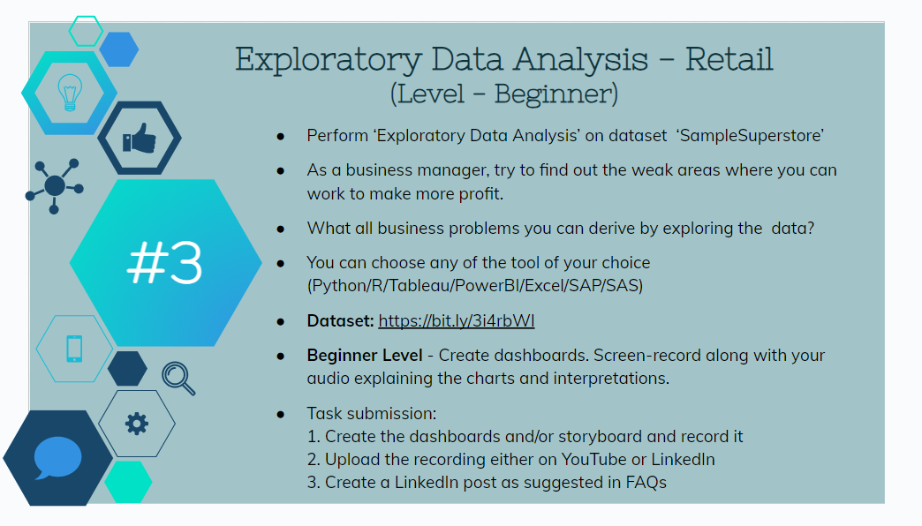

Slide 3
Questions that will help make better analysis
How many categories and Sub-categories are there?
What was the total quantity sold, total sales and the Profit?
Which category is best performing and how much profit it has made?
Which is the top selling Sub-category?
Which customer segment is most profitable?
Which is the preferred Ship Mode?
Which region is the most profitable and the region with the lowest profit?
which 5 Cities has the highest profit?
Which 3 Cities has the lowest profits?
Lowest performing Sub-category.

